Slide 1
01.09.2021

Slide 2
Driving aspiration
Over the last 12 years, the blockchain technologies have been steadily developing and are here to stay.
This will severely impact the banking industry. Just to list a few changes:
Crypto currencies are used as an investment and a mean of payment,
Stable coins which are popular in the DeFi world will streamline payments in Fiat,
Central Bank Digital Currencies will be around in few years and could disrupt the banking landscape,
Tokenization will in the mid-term bring a lot of efficiency to the securities,
Collateralization is more transparent when performed by a smart contract
GPBS has decided, since end 2018, to create a crypto product for its different customer segments. The aspiration is to be ready for the coming disruption offering seamless integration to blockchain based products and services.

Slide 3

Where to Play
Requests from GPBS clients
Targeted GPBS solutions with the Digital Asset Initiative
Custody of digital assets in regulated environments
Investments in digital and alternative asset classes (e.g., crypto-currencies, Non-Fungible Token)
Crypto-collateralized loans
Crypto-Ecosystems (illustrative)
Potential roles for GPBS
Wallet
Wallet
Private clients
Interface
Custodian
Issuer
Broker
Wallet
Distributed Network
Wallet
Investment in digital assets
Financing (e.g., digital bonds, tokenized physical assets)
Crypto-collateralized loans and bank guarantees
Access new export finance platforms
GPBS client
Wallet
Wallet
Corporates
GPBS roles
Interface
Custodian
Issuer
Broker
Custody of digital assets
Collateralized loans
Help issuing and distributing funds as digital assets
DeFi connectivity including stablecoin support
Institutional
GPBS offering
Secure and regulated access to crypto-ecosystems
Place buy/sell orders
Instruction of transfer digital assets from/to custody accounts
KYT and AML for crypto transactions
Secure storage of digital assets and credentials*
Settlement of buy/sell orders
Consolidated reporting services
Investment services
Helping clients to issue digital assets for financing purposes
Supporting tokenization of physical assets
Placing buy/sell orders on the distributed networks
Access to traditional banking services (accounts, fiat-currencies, transaction banking etc.)
Stablecoin default guarantees and collateral management
Access to custody infrastructure
CASP*
Provided by …
GPBS
GPBS
Partner
Partner (or GPBS itself later)
CASP = Crypto-Asset Service Provider
Source: Qualitative online interview with Prospects, Feedback from client meetings

Slide 4
How will we win?
Our value proposition is:
Custody from a regulated entity,
Seamless integration of crypto with the other fiat services (buy, sell, reporting),
Gateway between crypto and traditional finance:
Fiat services for investors,
Stable coin guaranties,
Blockchain based commodities services (LCs, BLs, …)
Our competitive advantage is:
Swiss regulated entity,
Swiss subsidiary of strong group,
Strong positioning in the Russian Zug crypto community,
Strong positioning in the Commodities business,
Small entity in Switzerland able to quickly adjust to the market’s moves.

Slide 5
What capabilities?
The main capability is to have crypto trained people. Since the project’s start in 2019, rounds of trainings have been conducted and the staff is fully operational
Crypto understanding at senior level is a key capability which has been developed along the project
Finma license: the current license is too restrictive as we can only offer bitcoin. The extension to Ether and Digital Assets has been fully prepared and audited
Processes and responsibilities have been defined in directives
Product innovation: building new products including business, legal, operational and technical aspects
Technical capabilities:
A vault for the custody: this is in place since 2020
A crypto enabled core banking system: this is in place since 2020
Access to liquidity providers: our technical solution provides an automated access to CBAG
E and mobile banking access: current only read only access is available, trading should be enabled in Q1 23
Compliance checks and the associated tooling is in place

Slide 6
Management systems required
Present and regularly update the teams on the crypto project
Continuous crypto training for the staff to ensure a strong expertise among the different teams
KPIs to measure:
Technical progress of the platform
Progress on different channels (Private Banking, Corporates, Institutional, CASPs):
Sales pipeline reviewed weekly with the different teams
Assets volumes in custody
Transaction fees
Regular reviews of the project and its KPIs with senior management

Slide 7
Market Segments

Slide 8



Private customers - Context
The crypto winter we face since S1 2022 highlights the importance of counterparty risk as we have seen with the crash of Terra/Luna or 3ACapital.
This demonstrates to private investors the importance of regulated counterparts for custody, stable coins and lenders, together with reducing the frictions between traditional and crypto finance.
Despite the severe correction, the crypto volumes have only reduced by a little compared to the all-time high. The search of crypto keywords on Google has not significantly reduced. To put things in perspective, the price correction is similar to the drop of some Nasdaq stocks.
Note that the DeFi exchanges have not stalled during the crisis despite the stress on the prices and volumes. Volumes on DeFi are still quite high.
The crypto offering in the market is expanding as the crypto specialists (Bitcoin Suisse, Seba and Sygnum) have established partnerships with traditional players. Some established actors like Vontobel and Swissquote have already developed a profitable crypto business.
Some large incumbents like Postfinance have also announced that they will offer crypto products to their customers.

Slide 9
Private customers – Our Offering
Our offer brings:
A safe custody managed by a regulated entity with a decent equity backed by a large group,
Manual trading for significant investments,
Settlement integration: no need to transfer cash or to purchase stable coins. Crypto is bought from the cash account,
Access to real crypto products: customers are buying real cryptos, not ETFs which embed a counterparty risk,
The portfolio gives a 360° view on all the assets (traditional and crypto),
Lombard loans on Digital Assets (possibly including NFTs),
Selection of safer assets to navigate into the jungle of crypto assets,
Our offer is not:
A real time trading platform for traders. It does not compete with advanced pure players solutions,
A platform where all kind of products are accessible including the most risky ones,
Offering multiple prices coming from different exchanges,
For now, offering a on-line trading (will be available in Q1 23)
Market positioning:
An additional service for private banking customers
Which does not compete with pure players but offers better guaranties (license and capital)
And brings a one stop shopping to private customers

Slide 10
Private customers
Strengths
Weaknesses
Regulated in Switzerland, Part of a large group Convenience: seamless crypto integration Widespread crypto expertise within the team Regulated custody in place | Market access is sourced from other players, difficult to compete on prices GPBS is not well known actor in private banking, not easy to reach regular private customers Limited product scope for now as GPBS is only licensed on Bitcoin
Counterparty risks have materialized, more established players are well positioned Some active crypto players belong to the Zug Russian community | Geopolitical situation impacting: The license from Finma The relationship with providers Lower interest from private customers due to the current low market
Opportunities
Threats

Slide 11
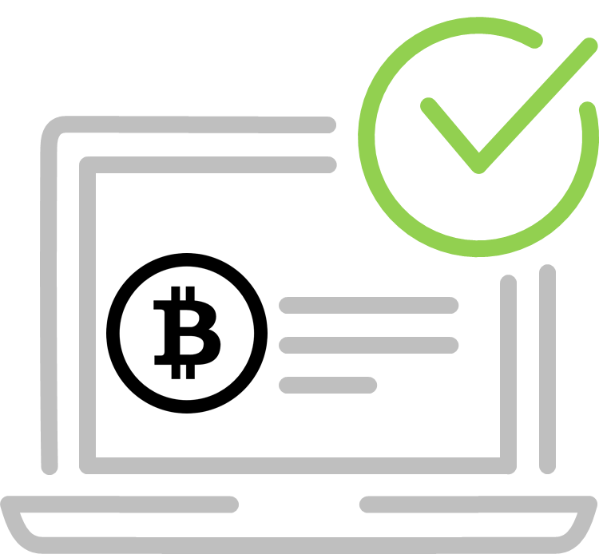

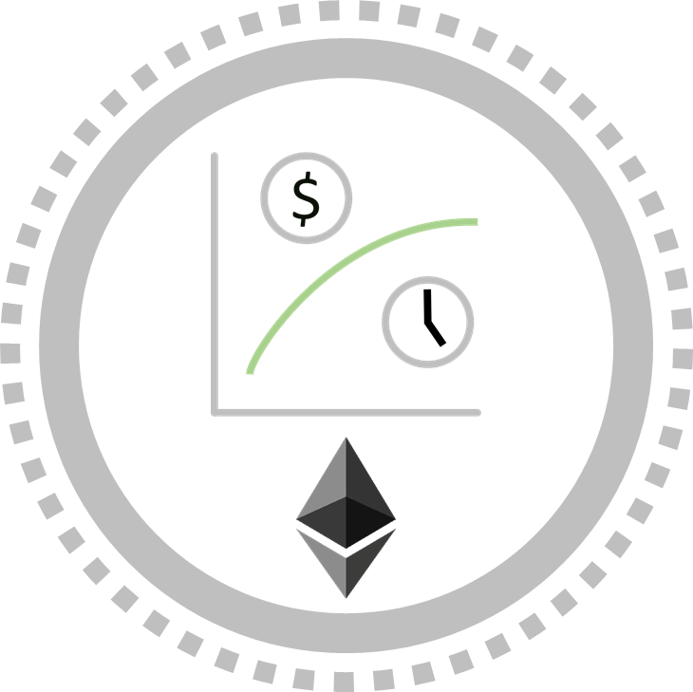
Corporates - Context
As inflation is accentuating the existing monetary erosion, a number of companies have or are considering investing a portion of their treasury in and this despite the high volatility on those assets: MicroStrategy holds 130K BTC (07.22), Tesla 10.7 K, Block 8K
Some companies also use crypto for payment either enabling purchases in crypto (Paypal, Newegg, …) or also paying in crypto. For those, hedging the crypto variation risk would be a big plus.
Corporates cannot afford to loose their profit in market fluctuations. This is why stable coins are an attractive instrument delivering an instantaneous payment to counterparts.
Stable coins can also be associated with smart contracts to enable a swap between a utility token and a stable coin. In the utility token matter, corporates could also need the banks’ expertise.
Digital Bonds are interesting products for corporates to diversify their sources of financing and lower the cost of an issuance by short cutting some intermediaries.
The Tokens infrastructure is not yet ready for mainstream distribution, nevertheless those products (as well as Equities) could become popular in private placements.

Slide 12
Corporates
Our offer brings a standard base offering:
Regulated custody and settlement
Crypto as a treasury product giving market access for large tickets
Payments in crypto (Not yet available, needed an extension of the GPBS license)
It also brings customized services:
Stable coin guaranties for an internal coin used to transfer value between subsidiaries (or even close partners)
Issuance of digital bonds as a private placement which shortcuts a number of expenses faced in a regular issuance
Blockchain applied to commodities: in order to streamline the LC and BL processes and possibly also help to distribute those assets in some sort of a secondary market
Blockchain based auxiliary services: such as utility tokens, loyalty programs, …
1 – Corporates using Crypto Deloitte Report

Slide 13
Corporate
Strengths
Weaknesses
Regulated in Switzerland Part of a large group Convenience: seamless crypto integration Widespread crypto expertise within the team Regulated custody in place Existing customer base Commodities expertise | Limited product scope for now as GPBS is only licensed on Bitcoin
Corporates looking at investing in Crypto Digital Assets (Bond) for diversified and cheaper financing Crypto payments in BTC or stable coin Bear market, proper time to invest Commodities blockchain based services | Geopolitical situation impacting: The license from Finma The relationship with providers The attractiveness for customers
Opportunities
Threats

Slide 14
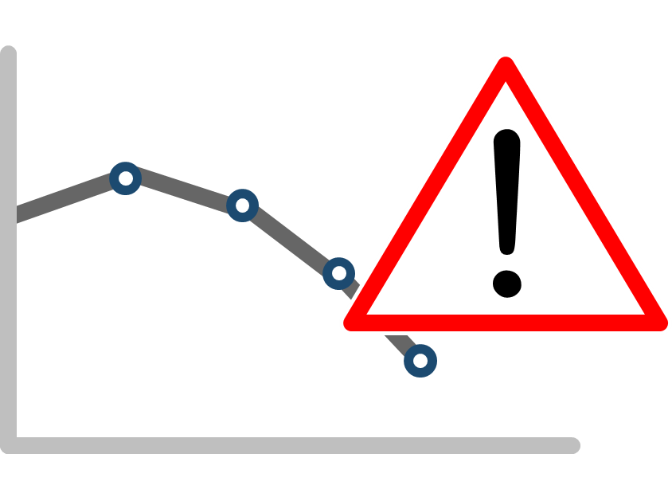
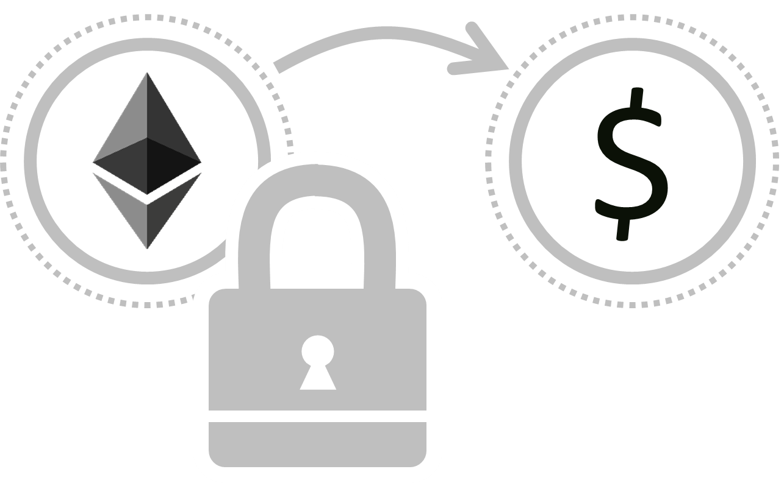
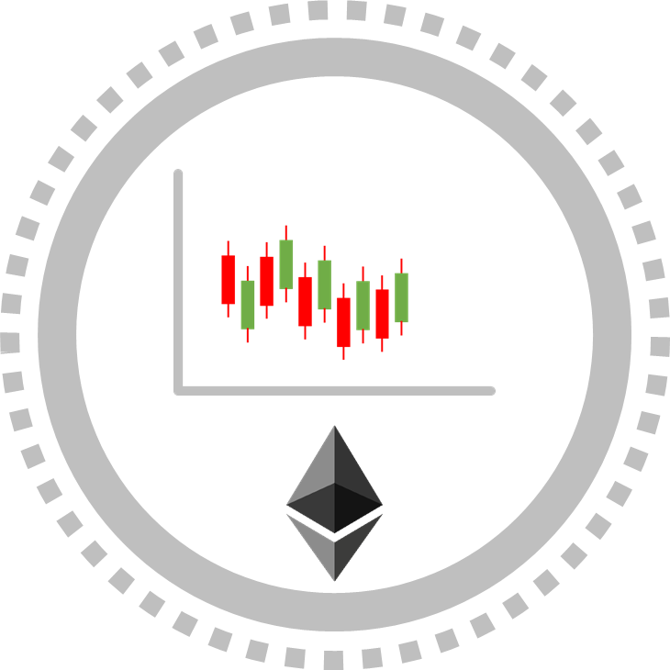
Institutional customers - Context
A number of funds and other financial vehicles have made some crypto investments to boost their performance with some volatility.
Not all those organizations have been able to manage securely their coins. With the crypto winter, they may feel at risk leaving their coins by an exchange which could go bankrupt.
Collateralized loans help institutional customers to optimize their portfolios’ yield keeping their cryptos and investing into other assets.
Tokenization of funds can help institutional investors to issue and distribute efficiently alternative funds which are poorly covered for now and potentially expanding to more mainstream funds.

Slide 15
Institutional customers
Our current offer brings:
Custody from a regulated entity, avoiding the risks coming from more fragile companies
This offer will be complemented by:
Collateralized loans (Q1 23 when the new Metaco version is available)
Tokenized alternate funds (When the extended Finma license or ERC20 is granted)
Distributing the funds managed by those customers to private customers and possibly to corporates
DeFi connectivity including stablecoin support in portfolios
Access to staking services
This offer does not cover:
Execution as it is sourced through partners

Slide 16
Institutional customers
Strengths
Weaknesses
Regulated in Switzerland Part of a large group Convenience: seamless crypto integration Widespread crypto expertise within the team Regulated custody in place | Limited product scope for now as GPBS is only licensed on Bitcoin Market access is sourced from other players, difficult to compete on prices Limited customer base
Institutional owning crypto needing a safe vault Bear market, proper time to invest | Geopolitical situation impacting: The license from Finma The relationship with providers The attractiveness for customers Large players entering in the space (Blackrock, State Street, BNP, …)
Opportunities
Threats

Slide 17
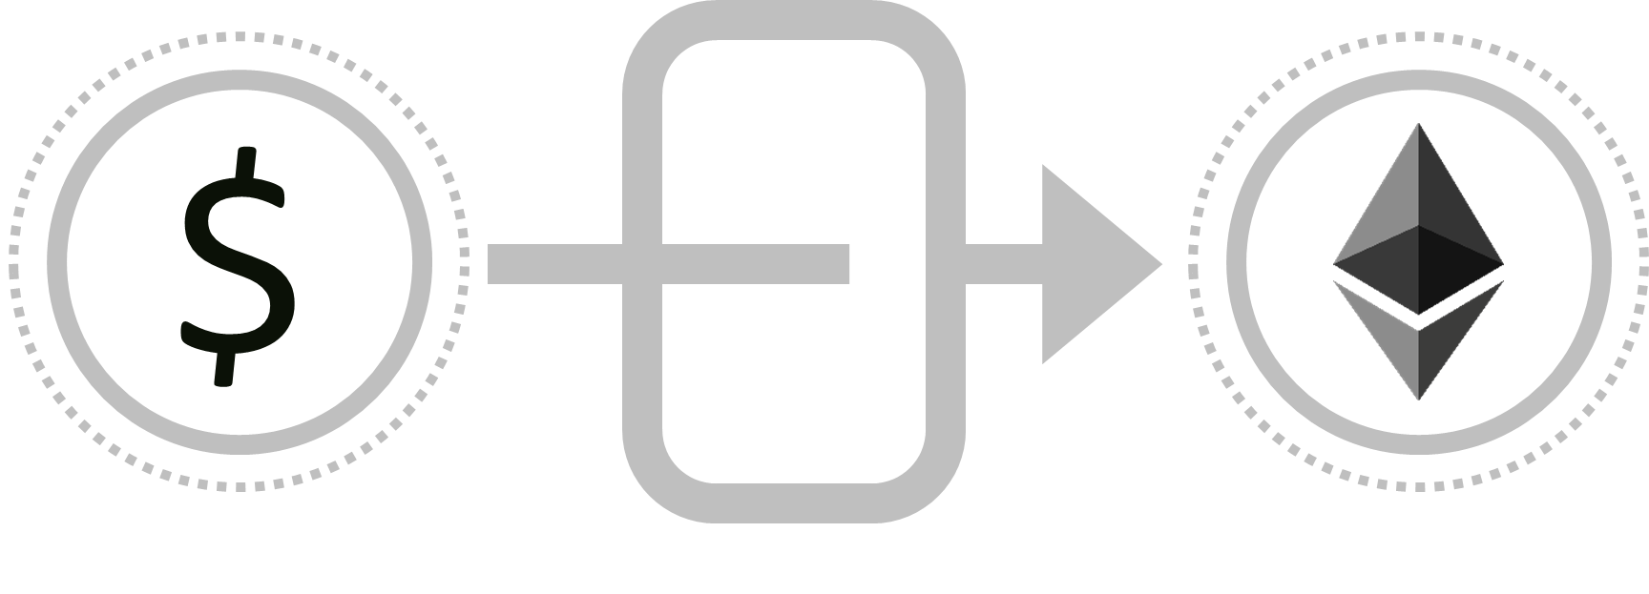
Fintechs and crypto pure players (CASPs) - Context
Fiat Gateway: CASPs are often struggling to access basic banking services (bank account, deposit from customers, guaranties). This creates tensions between the crypto and traditional worlds: investments from fiat to crypto and vice versa are made artificially difficult.
Stable coin have been tremendously successful in no time thanks the emergence of DeFi and the frictions mentioned above between traditional and crypto finance. The crash of Terra/Luna shows that algorithmic stable coins are difficult to tune, paving the needed for more trust and regulated options.
Tokenization is a generating a lot of hype but needs a more standardized infrastructure so that it can become mainstream, supported by an active secondary market and by common interfaces. A higher level of trust is also required to avoid the issues seen at the peak of the IPO wave where a number of fake projects have been issued.

Slide 18
Fintechs and crypto pure players (CASPs)
Our current offer brings:
Stablecoin services: flexible guarantee which can be adjusted on a regular basis by the issuer, information publishing on Ethereum, Chainlink and Ipfs about the guaranties and about the deposit transactions
Custody of digital assets and crypto currencies
This offer will be complemented by:
Fiat gateway to allow their customers to deposit fiat money (means also a significant KYC effort to check/onboard those customers)
Selling the tokens produced by those CASPs to our customers
Cross building products coupling together the pure players’ know how and the bank’s balance sheet and customer base
Share tokenization (cap table, selling to customers, ...)
This offer does not cover:
Execution is sourced through partners

Slide 19
Fintechs and crypto pure players (CASPs)
Strengths
Weaknesses
Regulated in Switzerland Part of a large group Strong in Fiat services Widespread crypto expertise within the team Regulated custody in place Agile in defining custom solutions Known as a crypto friendly bank | Limited product scope for now as GPBS is only licensed on Bitcoin but this does not impair other services
CASPs seeking for access to banking services | Geopolitical situation impacting: The license from Finma The relationship with providers The attractiveness for customers Bear market
Opportunities
Threats

Slide 20
Appendices

Slide 21
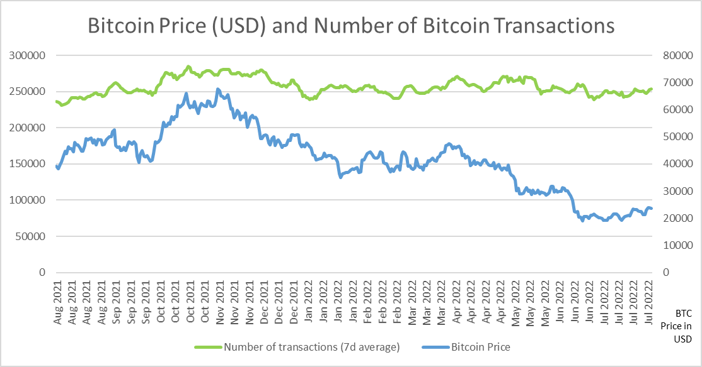
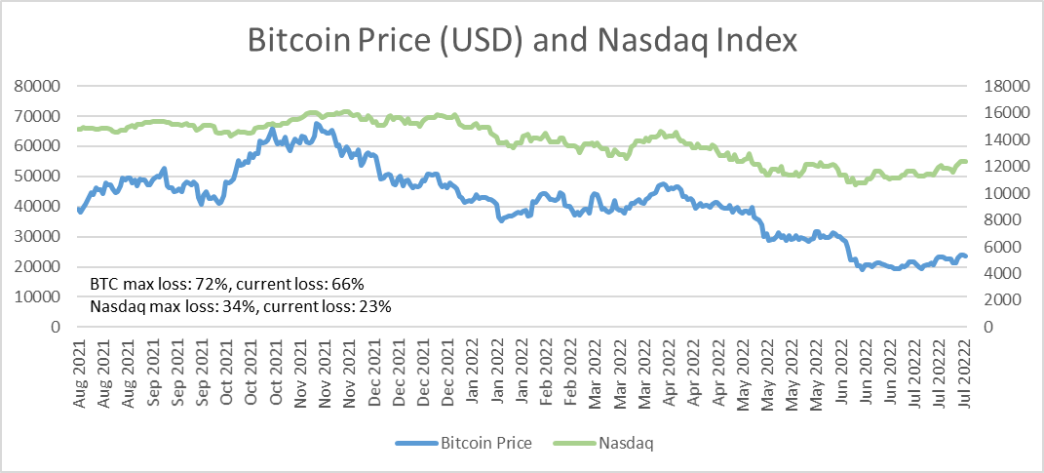
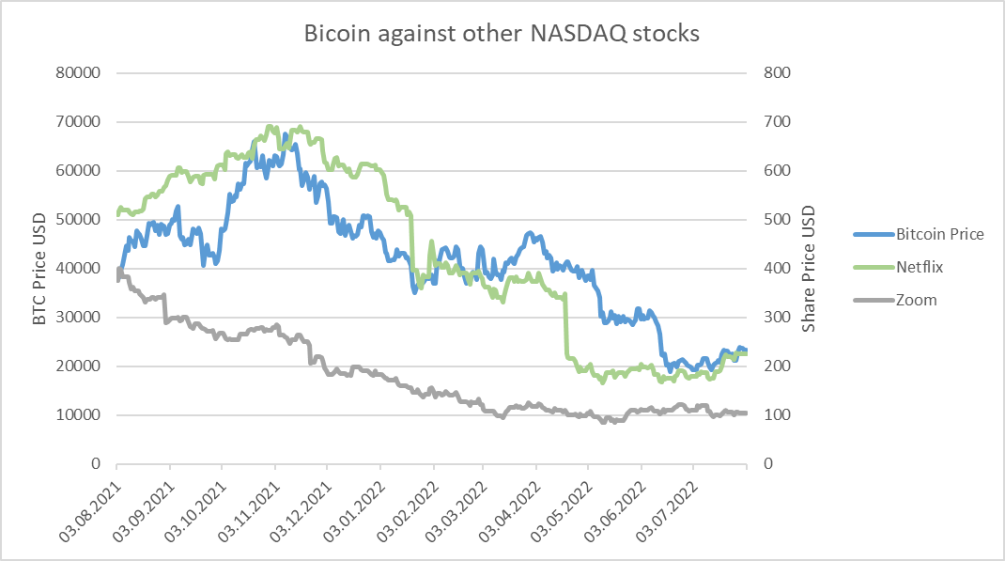
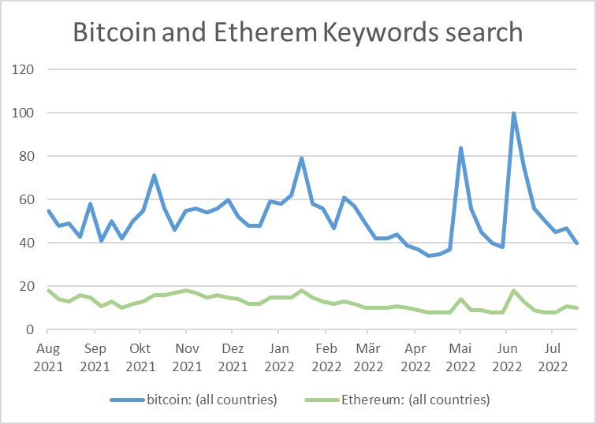
Crypto market
Table 1: Bitcoin Price and Number of Bitcoin transactions
Table 2: Bitcoin Price against Nasdaq index
Table 3: Bitcoin against low performing Nasdaq stocks
Table 4: Google trend keyword search

Slide 22
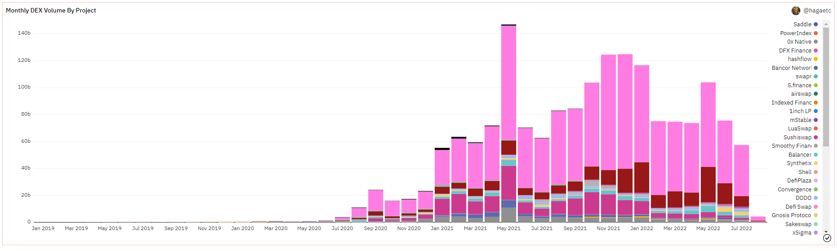
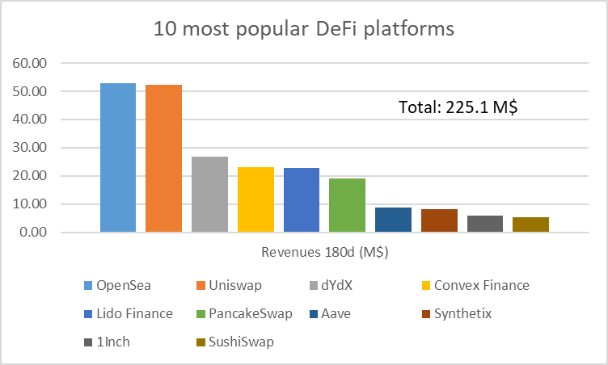
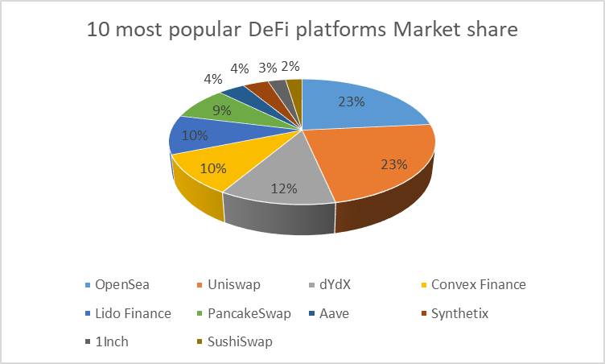
DeFi market
Table 5: DeFi volumes in USD per Exchange (source Dune.com)
Table 6: DeFi revenues 180d (source tokenterminal.com as of 10.08.22)
Table 7: DeFi maketshares 180d (source tokenterminal.com as of 10.08.22)

Slide 23
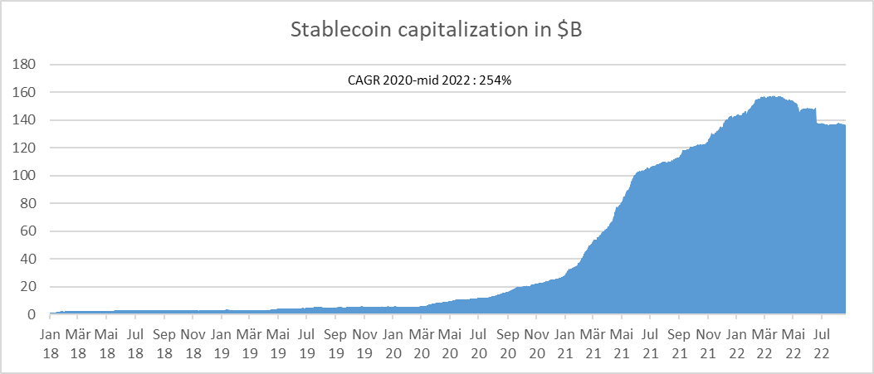
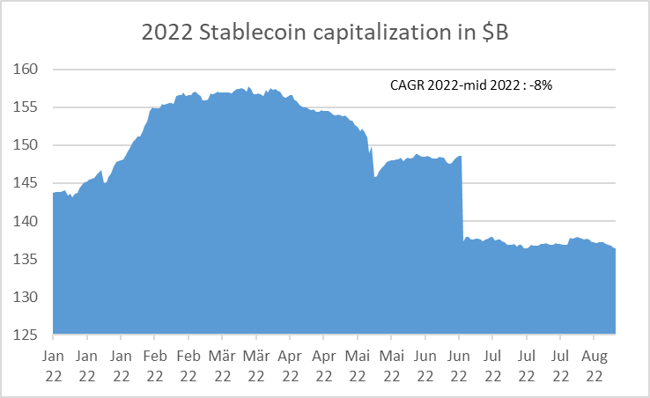
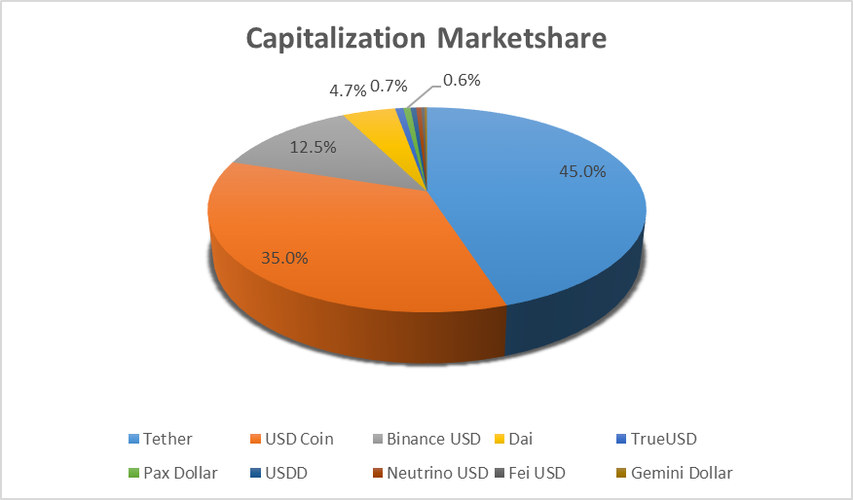
Stable Coin market
Table 8: Stablecoin Capitalization (source coinmetrics.io as of 22.08.22)
Table 9: 2022 Stablecoin Capitalization (source coinmetrics.io as of 22.08.22)
Table 10: Main stablecoins (source coinmarketcap.com as of 22.08.22)
Table 11: Stablecoins Marketshare (source coinmarketcap.com as of 22.08.22)

Slide 24
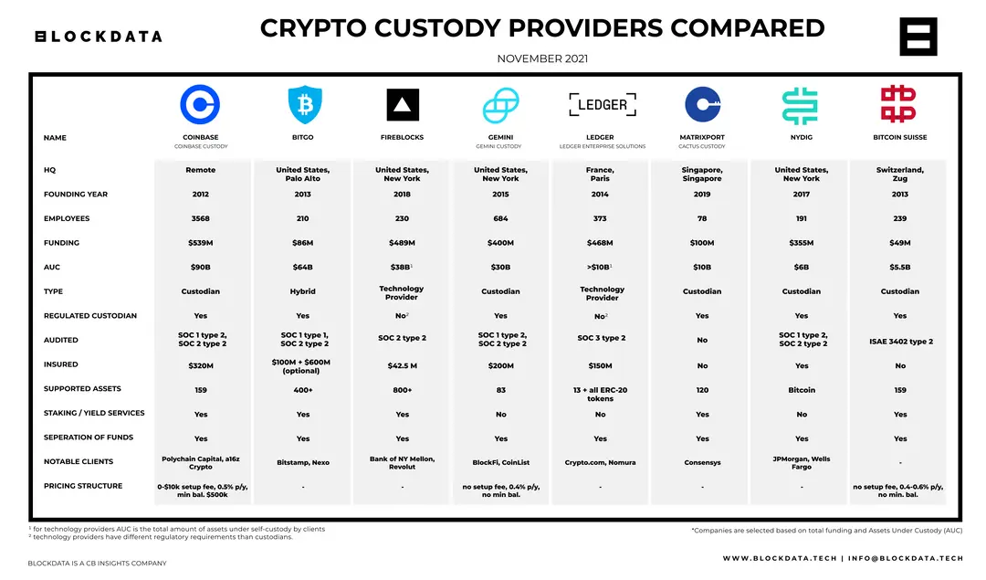
Comparison of custody providers
Table 12: Custody providers comparison

Slide 25
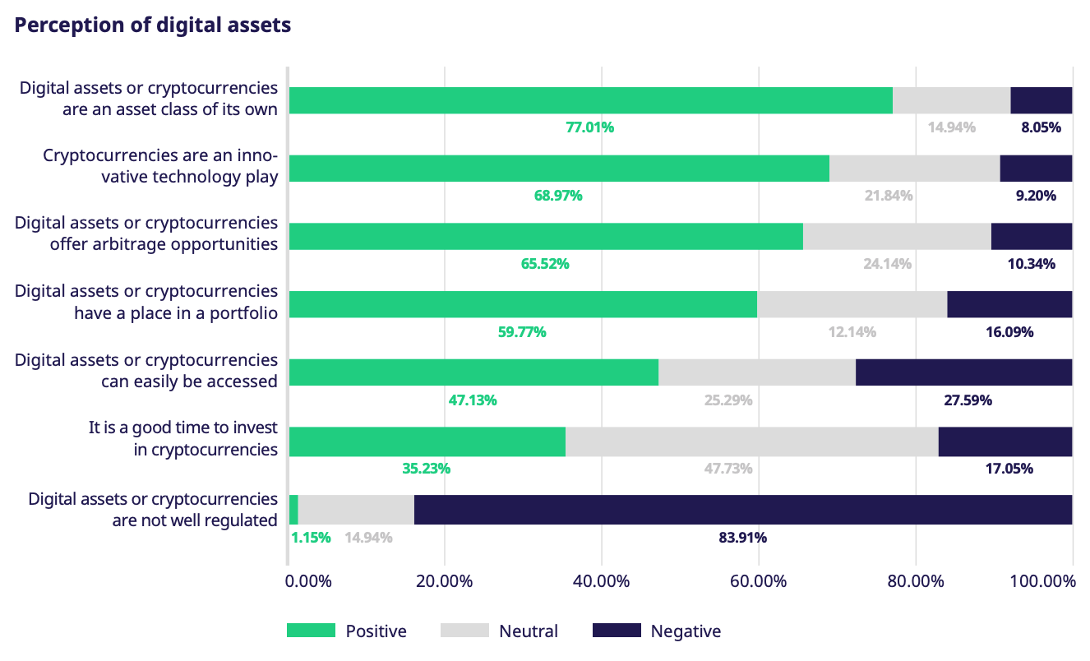
Perception of Digital Assets
Source: Digital Asset Trading 2021, Eurex
Table 13: Perception of digital assets

Slide 26
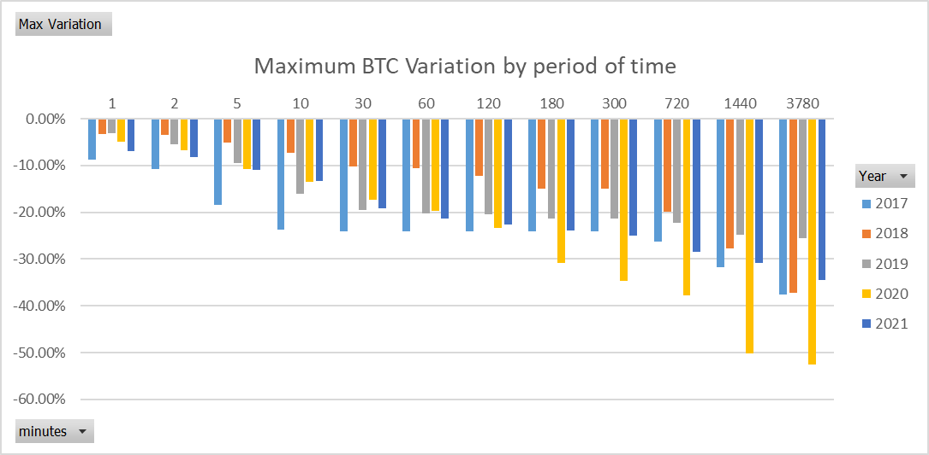
BTC Maximum Variations over the years
A 50% haircut is not enough over a night or a weekend
Table 15: Maximum BTC Variation by period of time
Table 14: Maximum BTC Variation by period of time

